Slide 1
Responsive Design in Android using Jetpack Compose
Exploring Concepts, Techniques, and Applications
Group Members Name: Chengkai Yang, Jingbo Wang

Slide 2
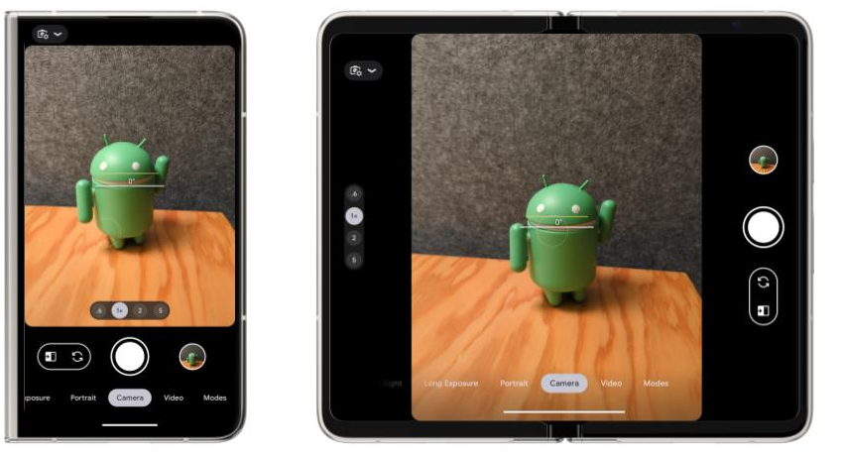
Introduction to Responsive Design
What is Responsive Design?
Responsive design ensures an app looks and functions optimally across different devices (phones, tablets, foldable screens).
Key goal: Adaptability to varying screen sizes, orientations, and resolutions.
Allows apps to be more user-friendly and versatile.
Image 1: Portrait rear camera preview on portrait outer screen and landscape inner screen of Pixel Fold

Slide 3
Jetpack Compose Layout System
Jetpack Compose: A Layout Revolution
Composable functions: Reusable UI components that automatically update based on state changes.
ConstraintLayout: Flexible layout to position items relative to each other.
BoxWithConstraints: Adjusts layout based on available screen space.
Supports state-driven UI to dynamically update the UI based on device configuration.

Slide 4
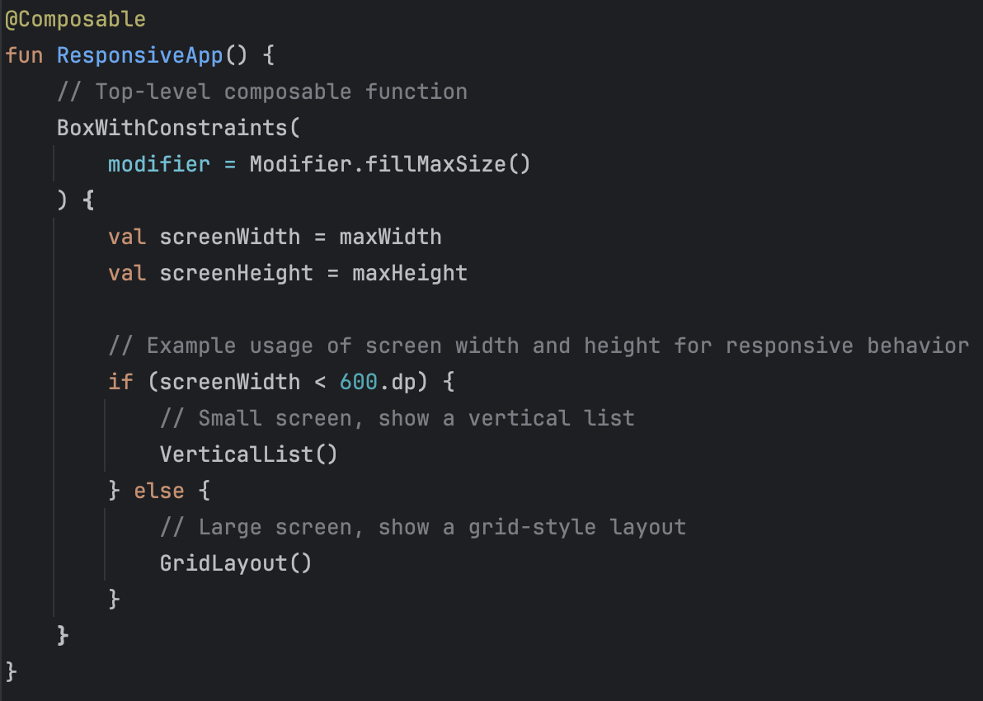
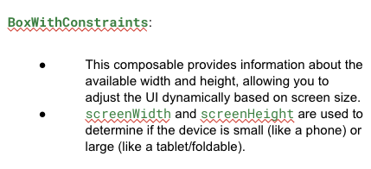
The layout structure in the code (BoxWithConstraints with dynamic behavior based on screen size) demonstrates how Jetpack Compose manages and adapts layouts for different screen sizes

Slide 5
Tools for Responsive Design in Compose
Techniques for Responsive Layouts
WindowMetrics API: Retrieve screen dimensions to modify layouts dynamically.
Modifiers: Use Modifier.aspectRatio(), padding(), and fillMaxSize() for scalable UIs.
LazyColumn and LazyGrid: Components to create flexible lists and grids that adapt to screen size.
Screen Density (DPI): Managing text and icon size with dp and sp for different device densities.

Slide 6
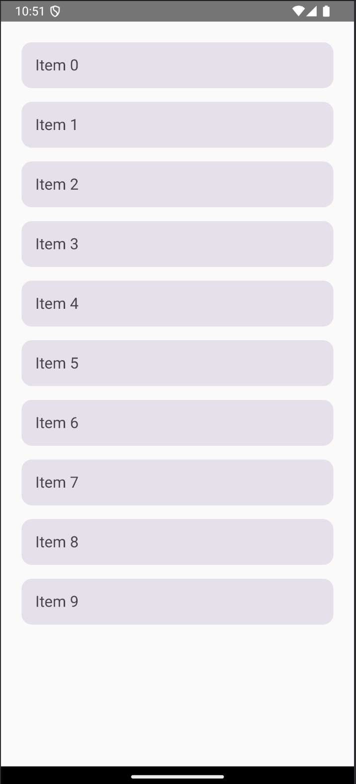
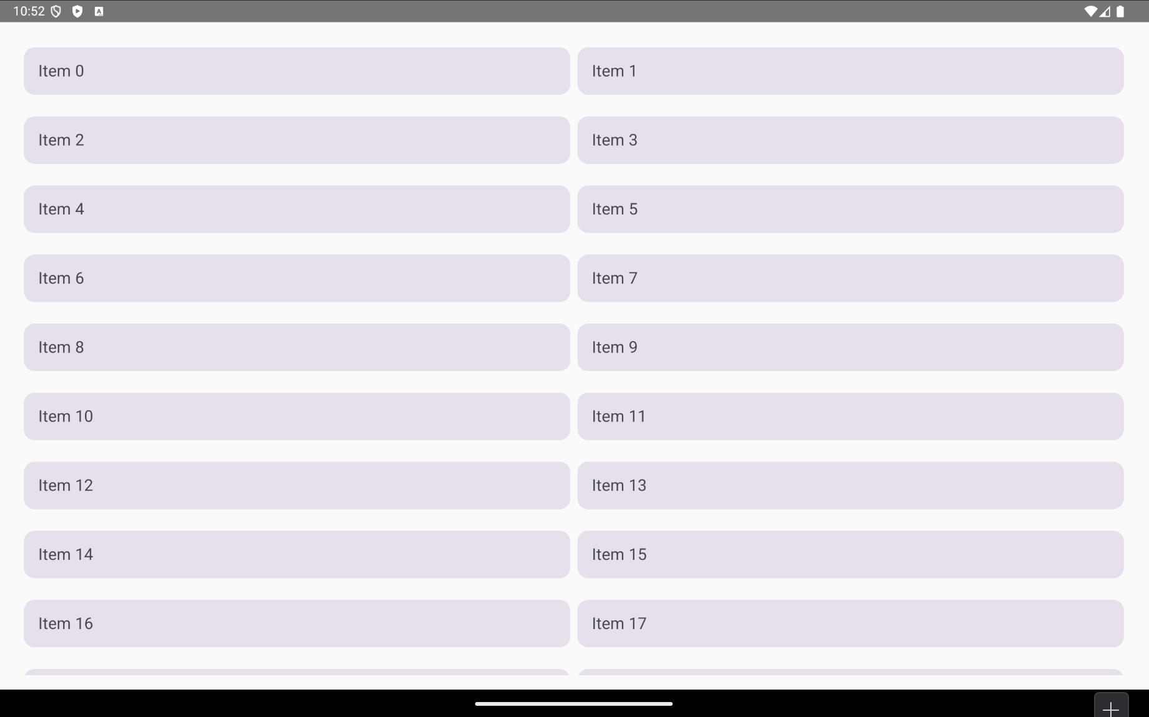
Comparison of two different screen sizes using the same Composable
BoxWithConstraints:
This composable provides information about the available width and height, allowing you to adjust the UI dynamically based on screen size.
screenWidth and screenHeight are used to determine if the device is small (like a phone) or large (like a tablet/foldable).
VerticalList Function:
Displays a simple vertical list using LazyColumn, suitable for smaller screens.
Items are placed in individual cards with padding.
GridLayout Function:
Shows a grid-style layout using rows, which is more suitable for larger screens (e.g., tablets or foldables).
Each row contains two cards, making it look like a grid.
Preview the Layout:
Use the @Preview annotation to visualize how the layout looks.
You can run the app on different emulator configurations to see how the UI adapts.

Slide 7
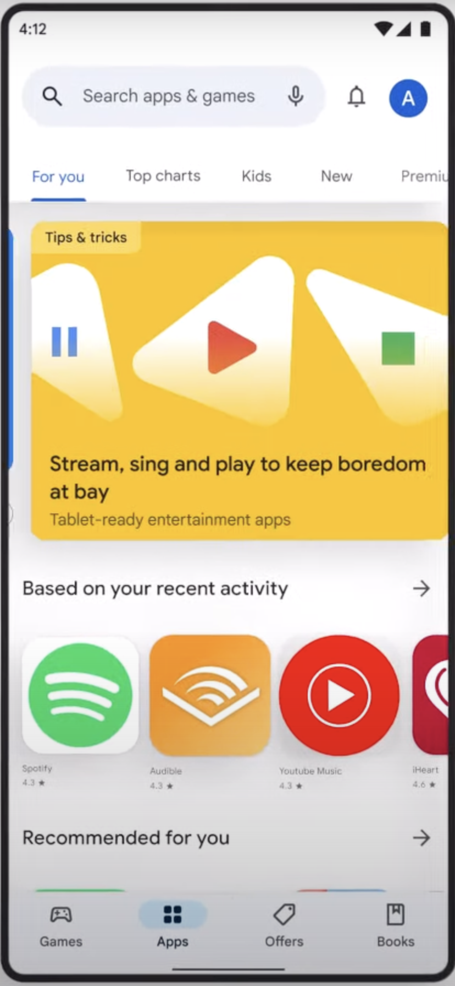
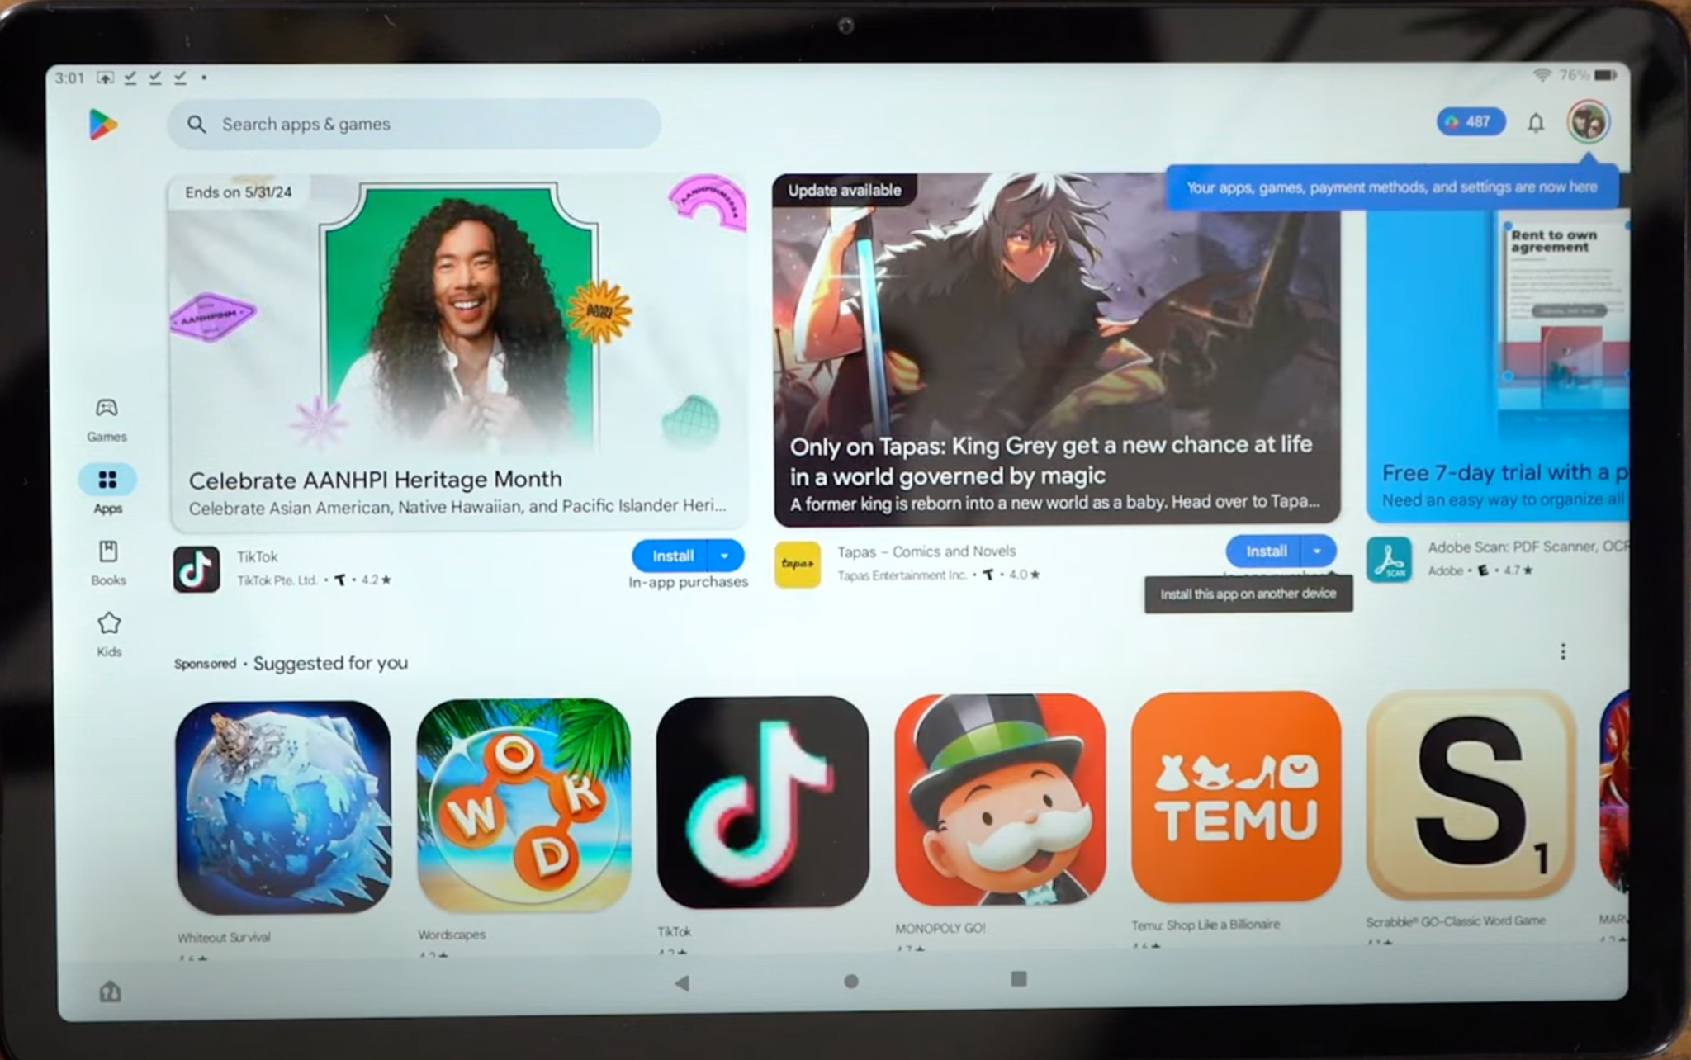
Case Study – Google Play Store
Google Play Store Responsive Design
Play Store adapts seamlessly across devices, optimizing layout for portrait and landscape modes.
Adaptive grid layout for app listings: More columns on larger screens (tablet, foldable).
Navigation drawer in portrait mode and permanent sidebar in landscape/tablet mode.
Image 2: Google Play Store in Landscape mode on Tablet (left image) and in Portrait mode on Phone

Slide 8
Conclusion and Best Practices
Conclusion: Best Practices for Responsive Design
Use Jetpack Compose’s adaptive tools (BoxWithConstraints, LazyColumn, etc.) for flexibility.
Test layouts across different devices and orientations for a seamless experience.
Incorporate dynamic scaling for text, images, and UI elements to ensure usability on all screen sizes.
Follow Material Design 3 guidelines for responsive and accessible UI components.

Slide 9
References
Android Developers. Layouts in Compose. Google Developers. Retrieved from https://developer.android.com/jetpack/compose/layouts
Android Developers. Adaptive Layouts. Google Developers. Retrieved from https://developer.android.com/guide/practices/adaptive-ui
Android Developers Blog. Building for Foldable Devices with Jetpack Compose. Retrieved from https://android-developers.googleblog.com/2021/09/foldable-devices-jetpack-compose.html
Google Developers. Building Responsive UIs in Compose [Video]. Retrieved from https://www.youtube.com/watch?v=szbZ5HnpqtQ

Slide 10
Image Source
Image 1： https://android-developers.googleblog.com/2023/06/pixel-fold-and-pixel-tablet-developers-guide.html

